Slide 1

Smart Ride-Hailing System A Digital Public Good for Sierra Leone PROG 102 - Principles of Software Engineering Group [2] Date: [Presentation Date
Name:
Alpha Rahman Sesay
Jospeh Vandy
Solomon

Slide 2
INTRODUCTION
Overview
SDG Relevence

Slide 3

The Problem We Are Solving
Informal and unregulated transport system
Lack of transparent pricing
Safety concerns
Limited opportunities for drivers

Slide 4
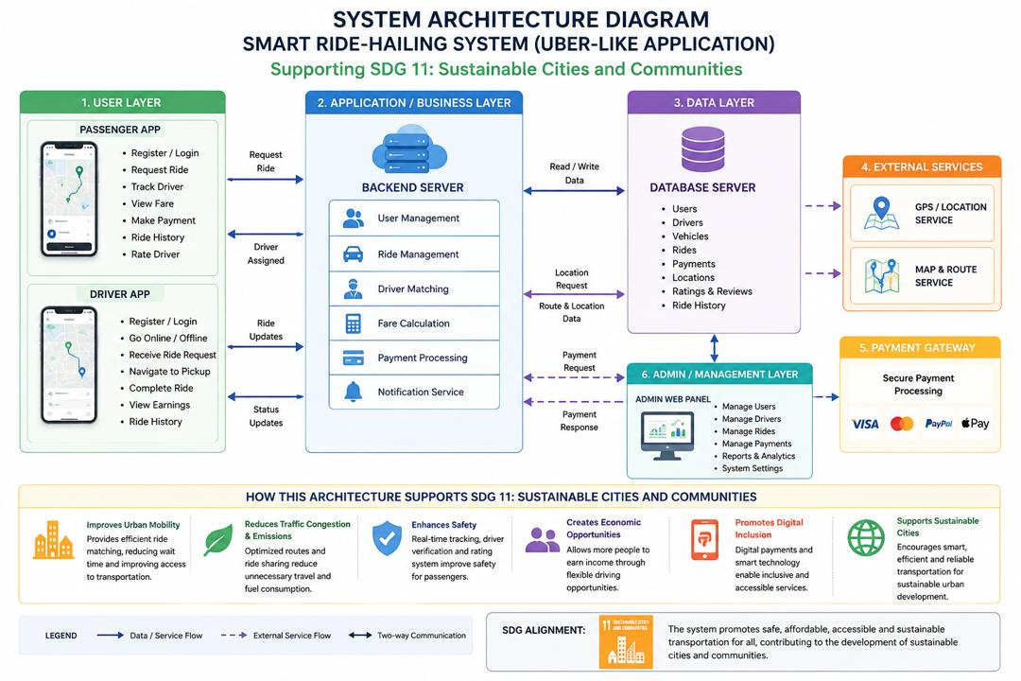
System Architecture Overview
5-Layer Architecture:
User Layer
Business Layer
Data Layer
External Services
Admin Layer

Slide 5
Project Management - Gantt Chart
Project Phase & Core Tasks | Weeks | W1 | W2 | W3 | W4 | W5 | W6 | W7 | W8 | W9 | W10
Phase 1: Research & UI/UX Design (Tasks A & B: Planning & Figma Specs) | W1 - W3 | 🟩 | 🟩 | 🟩
Phase 2: Core Engineering & Data (Tasks C & D: Architecture & MySQL) | W3 - W4 |  |  | 🟩 | 🟩
Phase 3: Integration & Frontend Build (Tasks E, F & G: Backend, App, APIs) | W5 - W7 |  |  |  |  | 🟩 | 🟩 | 🟩
Phase 4: Validation & Deployment (Tasks H, I, J & K: QA, Admin Web, Release) | W8 - W10 |  |  |  |  |  |  |  | 🟩 | 🟩 | 🟩
Weeks 1-2 Requirements
Weeks 3-4 Architecture & DB
Weeks 5-7 Development
Weeks 8-9 Testing
Week 10 Deployment

Slide 6
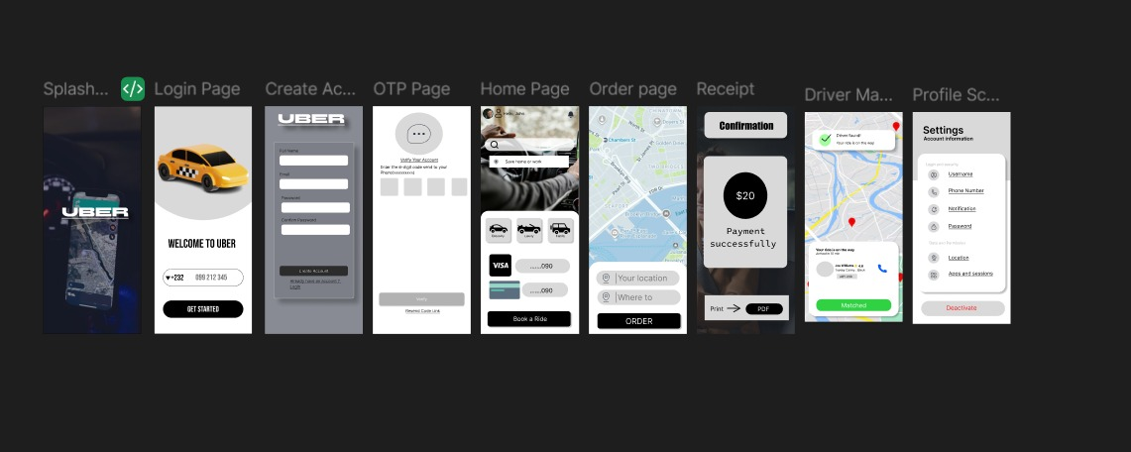
Prototype Screens (UI/UX)
Splash Screen
Login
OTP
Home Map
Request Ride
Tracking
Payment
Confirmation
Profile & History

Slide 7
Git & GitHub Integration
Repository with code, diagrams, SQL scripts, documentation, and commit history

Slide 8
Conclusion & Impact
Digital Public Good Aligned with SDG 11 Safe, affordable mobility Creates jobs Thank You

